Slide 1
Transactions
Concurrency Control

Slide 2
The Need For Concurrency Control
Databases contain information shared by many users
There is no interference problem
If all transaction execute serially, and each transaction commits before the next one starts
If all users are reading data
If all users access different parts of the database
However this is not the general case
In common applications two users may try to update the same records simultaneously or one of the users is updating records while the second user is reading them

Slide 3
The Need For Concurrency Control
Common examples of problems that may occur
1. The lost update problem
2. The uncommitted update problem
3. The problem of inconsistent analysis
4. The non-repeatable read problem
5. The Phantom data problem

Slide 4
1. The Lost Update Problem
John and Marsha have a common bank account with 1000$ Balance
They go to different ATMs but at the same time
John | Time | Marsha
BEGIN TRANSACTION | t1
Read BAL (reads 1000) | t2 | BEGIN TRANSACTION
 | t3 | Read BAL (reads 1000)
BAL = BAL – 200 | t4
WRITE BAL= 800 | t5 | BAL = BAL - 300
COMMIT | t6
 | t7 | WRITE BAL= 700
 | t8 | COMMIT
John has made a valid update that was lost because of the second transaction
Final BAL = 700

Slide 5
2. The Uncommitted Update Problem
This is also called the dirty read problem
Imagine an account with balance 1000$ and two transactions, one made by John trying to deposit 1000$ and one made by Marsha depositing 200$
John’s Deposit | Time | Marsha’s Deposit
BEGIN TRANSACTION | t1
Read BAL (read 1000) | t2
BAL = BAL + 1000 | t3
Write BAL (writes 2000) | t4 | BEGIN TRANSACTION
 | t5 | Read BAL (read 2000)
ROLLBACK | t6 | BAL = BAL + 200
 | t7 | Write BAL (writes 2200)
 | t8 | COMMIT
The first transaction is permitted to modify a value which is then read by the second transaction and the first transactions rolls back the update.
Final BAL = 2200

Slide 6
3. Inconsistent Analysis Problem
Bank Calculates Summary | Time | Marsha Transferring Amounts
BEGIN TRANSACTION | t1
SUM = 0 | t2 | BEGIN TRANSACTION
 | t3 | Read BAL_A (5000)
Read BAL_A (5000) | t4 | BAL_A = BAL_A - 1000
SUM = SUM + BAL_A | t5 | Write BAL_A (4000)
 | t6 | Read BAL_C (5000)
Read BAL_B (5000) | t7 | BAL_C = BAL_C + 1000
SUM = SUM + BAL_B | t8 | Write BAL_C (6000)
 | t9 | COMMIT
Read BAL_C (6000) | t10
SUM = SUM + BAL_C | t11
Write SUM (16000) | t12
COMMIT | t13
Marsha has 3 accounts each with 5000$
She decides to transfer money between the accounts while the bank executes a transaction to calculate the sum of money in each client’s accounts
The first transaction reads several values but the second transaction updates some of the values during the execution of the first
Final SUM= 16000$

Slide 7
4-5 The non-repeatable read - The Phantom data problem
The first transaction reads an item, another transaction writes a new value and the first transaction re-reads this time a different value
The first transaction reads some rows, another transaction inserts a new row and the first transaction re-reads the rows and sees a new one
John Deposits | Time | Marsha reading Balance
BEGIN TRANSACTION | t1
Read BAL(1000) | t2 | BEGIN TRANSACTION
 | t3 | Read BAL (1000)
BAL = BAL + 100 | t4
Write BAL | t5
COMMIT | t6 | Read BAL (1100)
 | t7
 | t8 | COMMIT
Bank Counts Accounts | Time | John Creates Account
BEGIN TRANSACTION | t1
COUNT Accounts (Read N) | t2 | BEGIN TRANSACTION
 | t3 | Create new Account
 | t4 | COMMIT
COUNT Accounts (Read N+1) | t5
COMMIT | t6
 | t7
 | t8

Slide 8
Controlling Concurrent Access
Problem: in a multi-user environment, simultaneous access to data can result in interference and data loss
Solution: Concurrency Control
The process of managing simultaneous operations against a database so that data integrity is maintained and the operations do not interfere with each other in a multi-user environment.
Achieved by:
Serializability (Locking mechanisms)
Versioning.

Slide 9
Controlling Concurrent Access
1st solution is Serializability
Each transaction is entirely processed before another one is allowed to start
Achieved by Locking Mechanisms
The most common way of achieving serialization
Data that are retrieved by a user for update are locked to other users
No other user can perform update or even query data (to avoid unrepeatable read and phantom data) until unlocked

Slide 10
Example: The use of record locks to enforce serialization and avoid the lost update problem
John | Time | Marsha
BEGIN TRANSACTION | t1
Request to Read BAL | t2 | BEGIN TRANSACTION
Lock Account | t3 | Request to Read BAL
Read BAL (reads 1000) | t4
BAL = BAL – 200 | t5
WRITE BAL= 800 | t6
COMMIT | t7
Unlock Account | t8 | Lock Account
 | t9 | Read BAL (reads 800)
 | t10 | BAL = BAL - 300
 | t11
 | t12 | WRITE BAL= 500
 | t13 | COMMIT
John’s transaction will update the record
The DBMS locks the record before reading it into main memory
. . .
WAIT
. . .
Final BAL = 500

Slide 11
Locking Mechanisms
Types of locks:
Shared lock–Read but no update permitted
Used when a transaction is just reading a record
Aims to prevent another user from updating the record and placing an exclusive lock on it
A shared lock on a record prevents from placing an exclusive lock but not from placing another shared lock on that record
Exclusive lock–No access permitted
Prevents both reading and updating a record
It is placed when the transaction is preparing to update
An exclusive lock on a record prevents from placing any other lock on that record

Slide 12
Locking Mechanisms
John | Time
BEGIN TRANSACTION | t1
 | t2
Request to Read BAL | t3
Place Shared Lock on Account | t4
Read BAL (reads 1000) | t5
 | t6
Request to Update BAL | t7
Place X-Lock on Account | t8
BAL = BAL + 200 | t9
WRITE BAL= 800 | t10
 | t11
COMMIT | t12
Unlock Account | t13
Shared Lock
Exclusive Lock

Slide 13
Deadlock
An impasse that results when two or more transactions have locked common resources, and each waits for the other to unlock their resources
It happens because it is not always possible to specify in advance all the records that a transaction requires. Therefore we place the lock requests during the execution of the transaction as the need for records appear
John Transfer | Time | Marsha Transfer
BEGIN TRANSACTION | t1
Place Shared Lock on A | t2 | BEGIN TRANSACTION
Read BAL_A | t3 | Place Shared Lock on B
 | t4 | Read BAL_B
Request X-Lock on B (Try to transfer to B) | t5
 | t6 | Request X-Lock on A (Try to transfer to A)
 | t7
 | t8
The problem of Deadlock:
John and Marsha will wait forever for each other to release their locked resources!
. . .
WAIT
. . .
. . .
WAIT
. . .

Slide 14
Managing Deadlock
Two ways to handle deadlocks:
Deadlock prevention
Lock all records required at the beginning of a transaction
May be difficult to determine all needed resources in advance
Deadlock Resolution
Allow deadlocks to occur
Mechanisms for detecting and breaking them
Resource usage matrix keeps records of all locks and finds deadlocks as they occur
Then the DBMS resolves the deadlocks by “backing out” one of the deadlocked transactions
Any changes made by that transaction up to the time of deadlock are rolled-back, and the transaction is restarted when the required resources become available

Slide 15
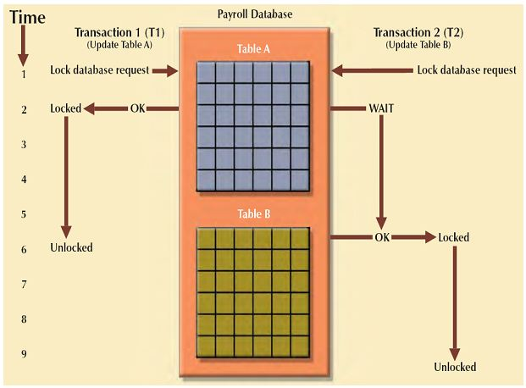
Locking Mechanisms
Locking level- is the extent of the database that is locked:
Database: used during database updates but impractical in general
Notes:
http://www.myreadingroom.co.in/notes-and-studymaterial/65-dbms/534-concurrency-control-with-locking.html

Slide 16
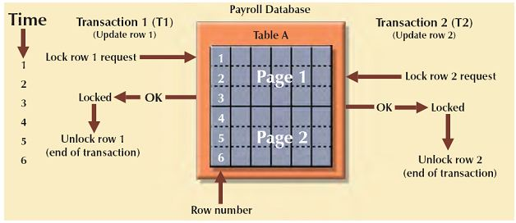




Locking Mechanisms
Locking level- is the extent of the database that is locked:
Database: used during database updates but impractical in general
Table: used for bulk updates but not suitable for multiuser DBMSs, where multiple transactions may wait to access the table
Notes:
http://www.myreadingroom.co.in/notes-and-studymaterial/65-dbms/534-concurrency-control-with-locking.html

Slide 17
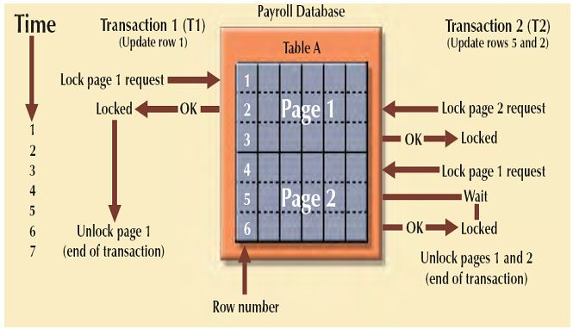
Locking Mechanisms
Locking level- is the extent of the database that is locked:
Database: used during database updates but impractical in general
Table: used for bulk updates but not suitable for multiuser DBMSs, where multiple transactions may wait to access the table
The physical storage block (disk page)- very commonly used
Notes:
http://www.myreadingroom.co.in/notes-and-studymaterial/65-dbms/534-concurrency-control-with-locking.html

Slide 18
Locking Mechanisms
Locking level- is the extent of the database that is locked:
Database: used during database updates but impractical in general
Table: used for bulk updates but not suitable for multiuser DBMSs, where multiple transactions may wait to access the table
The physical storage block (disk page)- very commonly used
Record: only requested row; fairly commonly used as it requires high overhead
Advantages of row-level locking:
Fewer lock conflicts
Makes it possible to lock a single row a long time.
Disadvantages of row-level locking:
Takes more memory than page-level or table-level locks.
Is slower than page-level or table-level locks when used on a large part of the table because you must acquire many more locks (examples: GROUP BY or full table scan).
Notes:
http://www.myreadingroom.co.in/notes-and-studymaterial/65-dbms/534-concurrency-control-with-locking.html

Slide 19
Locking Mechanisms
Locking level- is the extent of the database that is locked:
Database: used during database updates but impractical in general
Table: used for bulk updates but not suitable for multiuser DBMSs, where multiple transactions may wait to access the table
The physical storage block (disk page)- very commonly used
Record: only requested row; fairly commonly used as it requires high overhead
Field: requires significant overhead; impractical
Example usage: quantity-on hand in inventory control applications
Notes:
http://www.myreadingroom.co.in/notes-and-studymaterial/65-dbms/534-concurrency-control-with-locking.html

Slide 20
Controlling Concurrent Access
2nd solution is Versioning
Instead of locking
Optimistic approach to concurrency control
Assumption is that simultaneous updates will be infrequent
Each transaction is restricted to a view of the database as of the time that transaction started
When a transaction modifies a record, the DBMS creates a new record version instead of overwriting the old record
Each transaction can attempt an update as it wishes
The system will reject an update when it senses a conflict

Slide 21
Versioning
Versioning is like an archive room:
The records room has a service window
Users (corresponding to transactions) arrive at the window and request documents (corresponding to database records)
However, the original documents never leave the records room
Instead, the clerk (corresponding to the DBMS) makes copies of the requested documents and time stamps them
Users take their private copies (or versions) of the documents to their own workplace and read them and/or make changes
When finished, they return their marked-up copies to the clerk.
The clerk merges the changes from marked-up copies into the central database if there is no conflict
When there is conflict the documents with earlier timestamp are prioritized and committed. The other user must check out another copy of the data records and repeat the previous work

Slide 22
Quiz
Assume the following two transactions:
Read(a)
a = a+10
Write(a)
Read(b)
b=b*5
Write(b)
Read(a)
a = a*2
Write(a)
If the initial values are a=5 and b =20, write a concurrent access schedule to illustrate the lost update problem.

Slide 23
Quiz
Assume the following two transactions:
Read(a)
a = a+10
Write(a)
Read(b)
b=b*5
Write(b)
Read(a)
a = a*2
Write(a)
If the initial values are a=5 and b =20, write a concurrent access schedule to illustrate the lost update problem.
Apply the locking protocol to the schedule.
Does deadlock occur?

Slide 24
Quiz
Assume the following two transactions:
Read(a)
a = a+10
Write(a)
Read(b)
b=b*5
Write(b)
Read(a)
a = a*2
Write(a)
If the initial values are a=10 and b =20, write a concurrent access schedule to illustrate the lost update problem.
Apply the locking protocol to the schedule.
Does deadlock occur?
Apply the versioning protocol to the schedule. Will the schedule be executed? Are there any rollbacks?

